Slide 1
3. Study of basic operation of Linux system
Start up and stop of system
File manipulation
Directory manipulation
Low Level File System Structures
Introduction to shell

Slide 2
Start and stop of the system
To start the system, press the power button
When the system is starte, there’ll be login promt for username/password to enter to the system
After successful login, a command promt/graphics interface appears
To stop the system
press the power button
Use shutdown menu to stop the system
Use command shutdown -t
Notes:
To start the system, press the power button. Most of the machine will start the POST and the booting procedure without any additional action. But if there are more than 1 OS installed on the machine, it will prompt for boot system choice. By default, Linux bootloader has 2 boot option: normal boot an rescue boot. Booting to MS Windows option is avallaible when Windows is previously installed on the machine.
After loading the OS the system shows the login dialog to accept account information: username and password. User has to enter the correct username and password, and after successful login, a command promt/graphics interface appears. User can use menu or command promt to activate programs.
If user wants to stop the system, he can
press the power button. Be careful with this option, it’s avallaible only on the machine with AT power support. If not, the system will be stopped spontanneously causing loss of data and file damages.
The safer way to stop the system is to use shutdown menu to stop the system. This command can be accessed trhough start menu or by system context menu.
Most administrator shutdown the machine by using command shutdown. This command has several options that allows administrator customize the shutdown process such as sending an announce, scheduling shutdown, ….

Slide 3
File Manipulation
File and directory name and path
Creating files
Creating directories
Viewing directories
Viewing files
File and directory properties
Copying files and directories
Moving files and directories
Erasing files and directories

Slide 4
File and directory name and path
Root Directory
dev
etc
home
usr
tty
null
skel
mp
ux
bin
local
ucb
z036473
Home Directory
csci330
.cshrc
.logout
Notes:
Linux file system consitsts of files and directories. Hardisks physical blocs are grouped in a files by the content of the bits. Files are grouped in a directory to be found easier. Then directories and files are also grouped as a parent directory. This result in a hierarchie tree as in the figure. The root of the tree is the root directory (/). Partitions can be mounted as a directory to be access in the unique file system tree.
In the tree, there are two ways of locating a file or a directory:
By Using Absolute Pathname
Full pathname
Traces a path from root to a file or a directory
Always begins with the root (/) directory!
Example: /home/ux/krush/unix/assignments/assign1.sp04
By Using Relative Pathname
Traces a path from the ‘cwd’ to a file or a directory
No initial forward slash (/)
Two dots (..) goes up one level on file structure
Dot (.) points to current working directory (cwd)
Example: unix/assignments/assign1.sp04

Slide 5
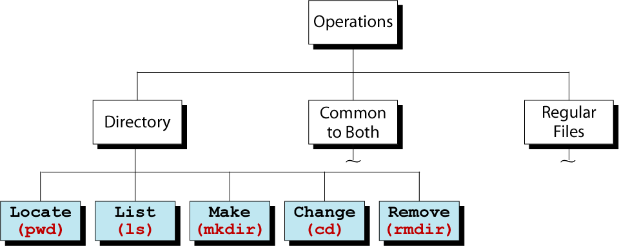
Directory Operation
Notes:
We have difined the basic elements of the file system. Of course, on these element, we can apply operations such as locate, list, read, create, change, remove, ….
The first operation is locate. Using command pwd we can determine in wich directory we are. This command is very useful when we are in a system with deeply organizzed directory. The current directory is a very important fact to determine relative path in other commands parameters. To change the current directory, use command cd.
To view the content of the directory, we use command ls. This command has one parameter, which is the path of the directory. The command has several option to customize directory contents displaying.
To create a directory, use command mkdir. By default, we can create a directory only if the parent direcory exists.Option –p allows recursive create parental directories.
To remove a directory, use the command rmdir. The directory must be empty. To remove directory recursivly, use command rm.

Slide 6
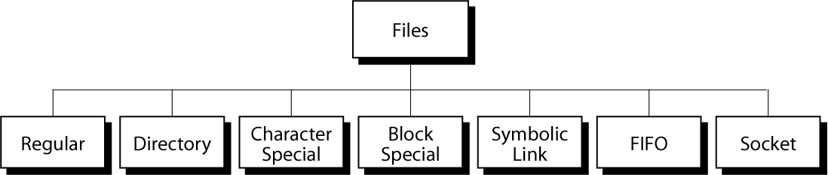
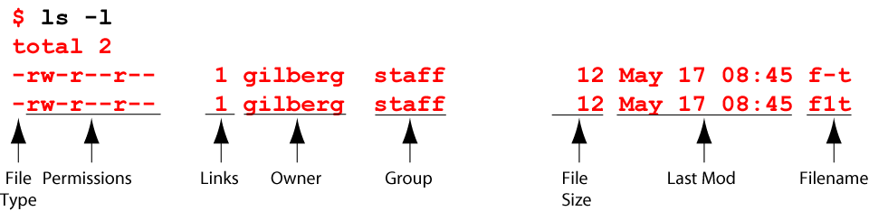
File and directory properties
- Text
- Binary
- Root (/)
- Home (~)
- Working (.)
- Parent (..)
Notes:
When using the command ls, the system display the directory content as in the figure. With –l full option, all file and directory properties are displayed. The first property is filetype. The second is the permissions that users can use this file/directory. The third is the number of link to the file. After that are the user and group owner. Permissions are defined in 3 groups: user owner, same group owner and the rest. Following is the modified time. The last information is the file name.
In Linux, everything is treated as file, even directory is a type of files. Linux uses 7 file types. Directory is a special file contents the list of files and sub-directories. Devices communicated by data blocks are symbolized by file type b. Devices communicated by characters are symbolized by file type c. Shortcuts to file and directory is l-type file. Communication chanels are presented by FIFO and socket type.

Slide 7
File Name Expansion & Wildcards
Allows you to select files that satisfy a particular name pattern (wildcards)
Character | Description | Example
* | Match zero or more char. | ls *.c
? | Match any single character | ls conf.?
[list] | Match any single character in list | ls conf.[co]
[lower-upper] | Match any character in range | ls lib-id[3-7].o
str{str1,str2,…} | Expand str with contents of { } | ls c*.{700,300}
Notes:
When working with files and directories, in many cases we need to find out and to process over files and directories. To specify these files and directories once, Linux allows us to specify part of the file and directory name. This is the use of what called wildcards.
Wildcards are special characters used to replace a character, a string satisfied predefined conditions. Linux has 2 set of rules to wildcards use. One is shown is the table. Other is using when specify parameters for several command such as find, grep, …..

Slide 8
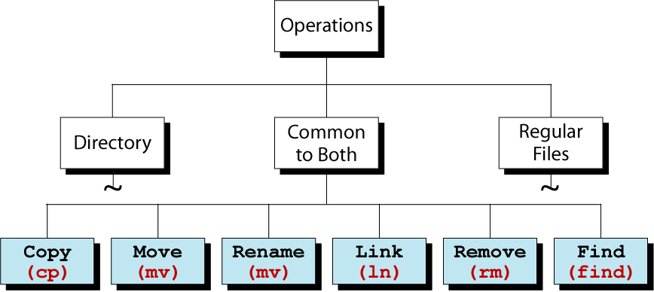
Operations Common to Directories and Regular Files
Notes:
Beside directory operations such as mkdir, rmdir, pwd, there are cpmmon commands for files and directory.
Copy (cp) allows us to copy one or more source to a destination.
Move (mv) move or rename objects
Link (ln) is used to create shortcut to objects.
Remove (rm) remove object from the directory.
Find allows us to locate objects by its name and properties.
To understand how these commands work, we need to look at the lower logical structure of a linux partitions.

Slide 9
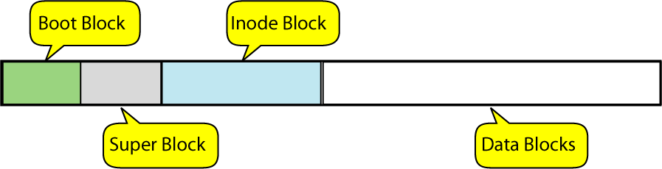
Blocks in a file system
Notes:
Hard disk space is divided in blocks. Data is stored in data blocks. These blocks a grouped in files. Each file contents blocks of data. The information for data blocks for each file is stored in a i-node block. Information about the partition itself is stored in super block. The first block in the file system content a kernel loader program and are called boot block.
To re-capitulate the block types:
Boot block – contains a small program called “boot program”, which is used to load the kernel into memory.
Super block – contains information about the file system; info = disk size, number of empty blocks, location of bad blocks.
I-node block – (information block) – contains information about each file in the data block. One unique inode of each file stored on the disk.
Data blocks – contains user files; it is where the data is stored.

Slide 10
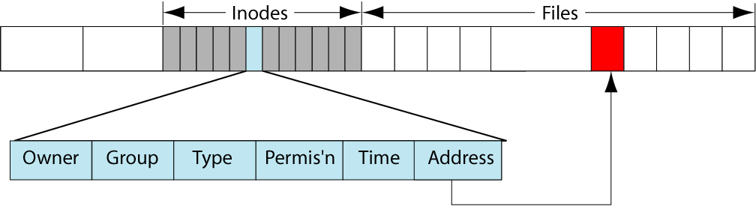
Inodes in a filesystem
Notes:
Index (or information) node: one i-node per file
Each inode has unique number. It contents information about File type, access permissions, link count, UID (user id), GID (group id), Date and time of the file’s last accessed, access permissions included: Data access (read and execute), Data modification (written), I-node modification (permission change) and list of Data blocks assigned to the file

Slide 11
I-node Structure
I-node
blocks
blocks
Access, Links, and other information
1
2
. .
9
10
11
12
13
blocks
blocks
indirect
block
double indirect
block
blocks
blocks
blocks
triple indirect
block

Slide 12
Directory representation
Directory is a file:
Has inode like regular file, but different file type
Data blocks of directory contains simple table:
Name | Inode number
Notes:
A directory is a regular file. The only different is the type of the file
The content of a d-file is shown in the figure. It consists a list of files in the directory, including sub directories. 2 special files: “.” and “..” are links to current and parent directories.
Back to the tree of the file system, the normal contents of directories allow us to navigate in the top-down way, i.e from the root directory i-node and the path we can find out the i-node of the directory specified by the path. The “.” and the “..” allow us to navigate in the bottom-up manner, i.e from the i-node of the directory specified by a path we can find out the root directory i-node

Slide 13
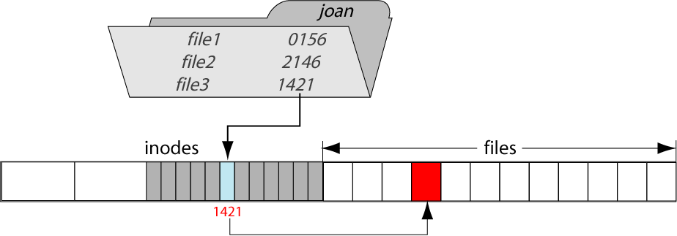
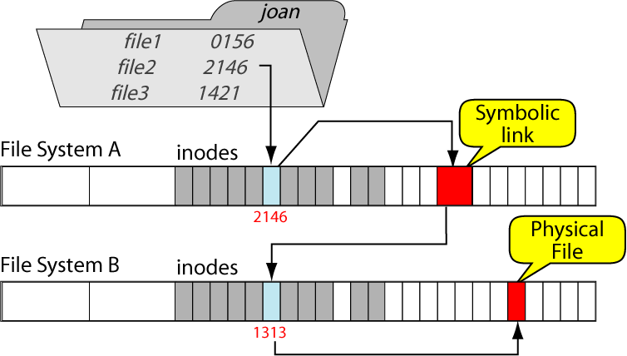
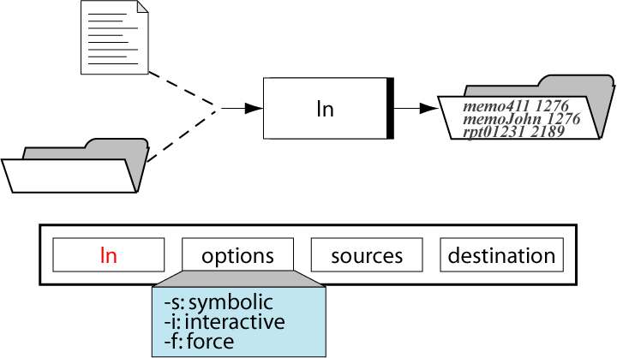
Links
Hard links
Symbolic links
The ln command
Remarks to use links
Notes:
Regularly we have to list files and directories in multiple directories to be accessed easier. We can do it by creating shortcuts (file contents link to destination) or by creating records in the directory content)
Symbolic links are files content the path and the name of the destination. It stays on the logical level view of the system.
Hard link are the record in the directory contents. That means the i-node can be targeted in more than one directory contents. When a file is removed, in fact only the record is deleted. If no record targets to an i-node, the file is not accessible and considered as deleted. In fact, there is no priority between records. Once a hard link is created, we can not distinct it with the original.
Links are created with the command ls
In the table below, some remarks about when to use symbolic and hard links

Slide 14
Hard Link
Contents of dir1
.
home
. | 1076
.. | 2083
aa | 2407
2406
z036473
2407
2408
dir1
dir2
.
aa
dir3
Contents of dir3
.
. | 1070
.. | 2050
bb | 2407
Data Block
bb

Slide 15
Symbolic Link
A hard link may not be created for a file on a different file system
Use symbolic link
The linked files do not share the same I-node number
Syntax: ln –s shared-file link-name
Also called source-file
Also called target-file

Slide 16
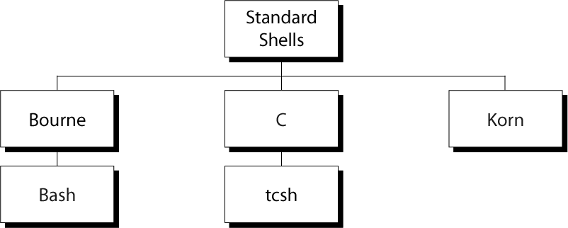
Shell
Notes:
Shell is a program that receive commands form users and passes them to the system to be executed. It’s interactive, i.e. once a command is executed, it returns and wait for user input.
There are several shells basic on standard shells. Shells are different in the way it support users, in style, in the keyboard shortcuts and many more.

Slide 17
Command Line Structure
mp% command [-options] [arguments]
Arguments can be:
1. More information
2. Object identifiers
3. Names of files
Command prompt
Command name
Command modifier; usually one character preceded by + or - sign
Notes:
UNIX is case sensitive!!!!
Example: the command “ls –l” is not the same as “LS –L”
Must be a space between the command, options and arguments
No space between the plus or minus sign and the option letter
Option letters must be typed exactly as they are indicated,
uppercase or lowercase
Fields enclosed in [ ] are optional
Must press [Return] after you have completed entry of a command
Notes:
Commands are entered to shell line by line. That the command line is a object that shell process each time.
The structure of a command line is shown in the figure. Shell displays the command prompt providing information about the path and the users. User has to enter the command name followed by a space. After that user can provide option to the command. At the end are the arguments-parameters of the command. Arguments of the command can be general information, object indentifies or file names.
Linux command are case sensitive. After enter the command, user has to press [Return] to execute the command.

Slide 18
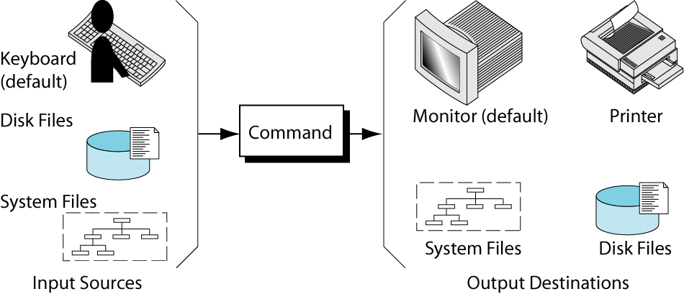
Command source and destination
Output Destinations
Input Sources
Notes:
A command has one input (source) and two output. Input are parameters entered after the command. Output is things that displayed in the monitor (destination). Linux provides one more output to show information about the errors occurs. By default, the input is attached to keyboard and outputs are attached to monitor. But they can be redirected to a file, to a physical device or anything that Linux considered as a file

Slide 19
Shell command
External command
Internal command
Shell support
Shell internal help functions
Command shell
Command shell support
man, apropos, whatis
Notes:
When execute a command, firstly shell verify if the command is shell code: internal command. If the shell does not provide the code for the command, it look for the command in system directory, load it and execute it. Or if the command is specified by it fully qualified name, the shell also load and execute the code. In the two latest cases, the command is called external.
Set of internal commands is provided by the shell, whereas external commands are provided by the system and application software.
There exists many commands in Linux. Users can not remember all of the commands and their options. To use them effectively, shells provide support for users to find out what command to use and how. As commands are internal and external, help functions also divide to internal and external commands.
To get help about external commands, we can use helper commands such as man, apropos, whatis.
Apropos and whatis provide the briefs information about the functions of the command
Man provide the detail information about the command.

Slide 20
Some basic commands
date
whoaim
finger
time
external and internal command
mc
emacs
vi

Slide 21
Summary
Understanding linux file system
Working with files
Working with directories
Working with shell
Programming with shell

